Slide 1

Hospital Management System (HMS)
.

Slide 2

TABLE OF CONTENTS
Introduction
The HMS System Components
About The Code
Unique Features
The Use Case Diagram And Class Diagram
Summary

Slide 3

INTRODUCTION
our Hospital Management System (HMS) aims to streamline patient management processes within healthcare facilities.
Key tools:
Programming Language: Java
Data structures: Greedy algorithms, and Array Lists.

Slide 4
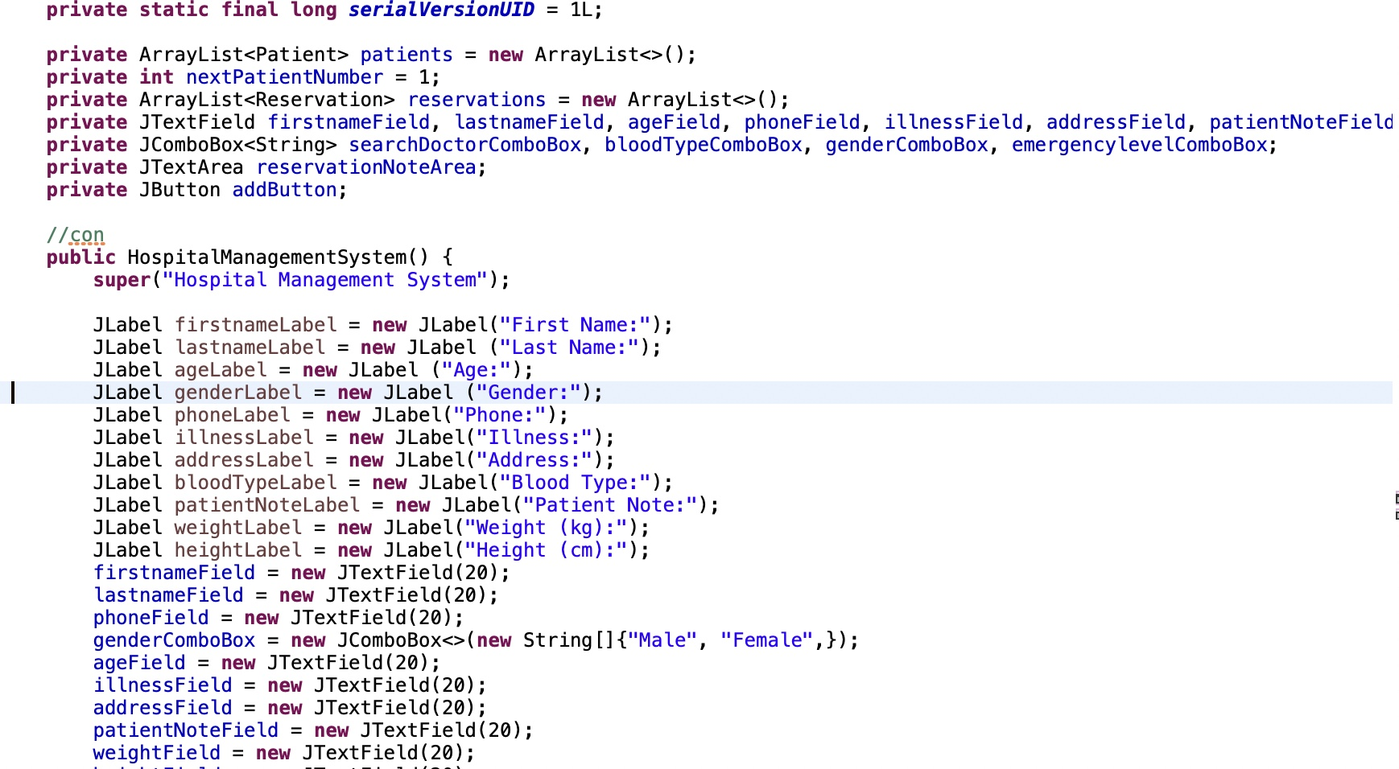
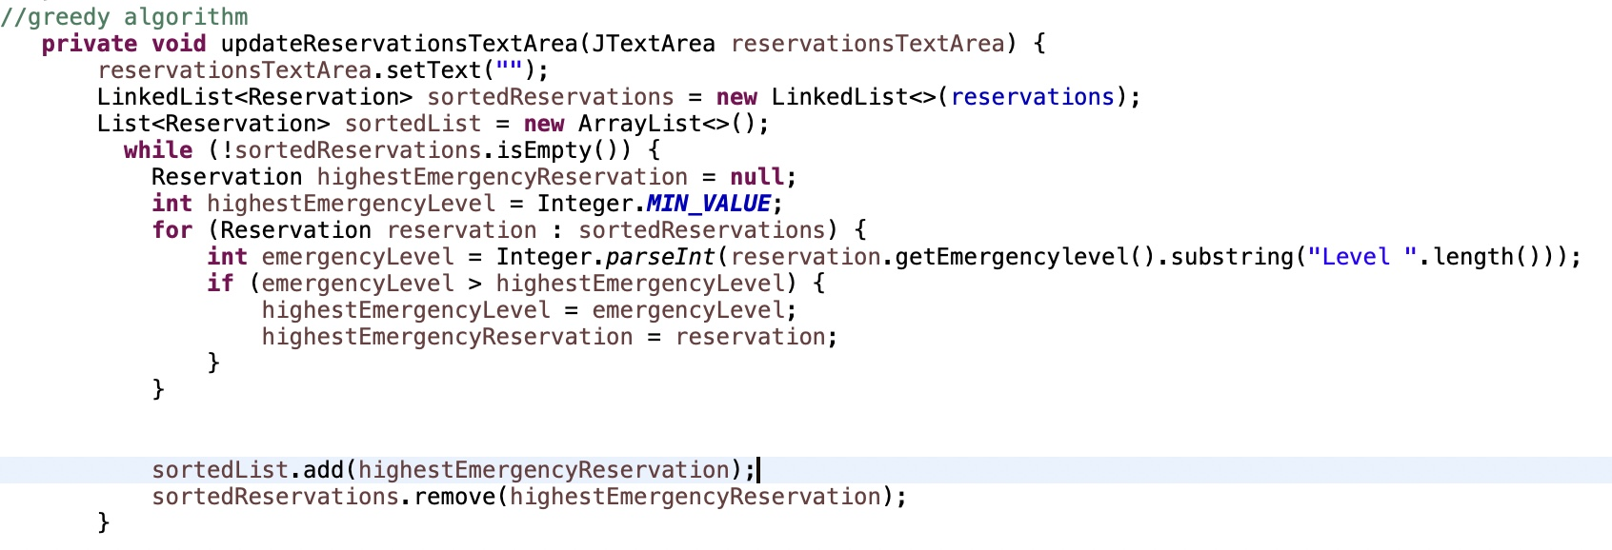
DATA STRUCTRURES USED
Array lists
Greedy algorithms

Slide 5
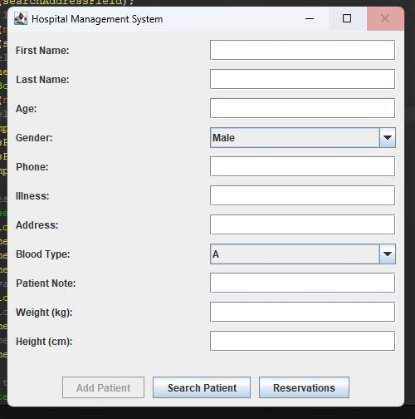
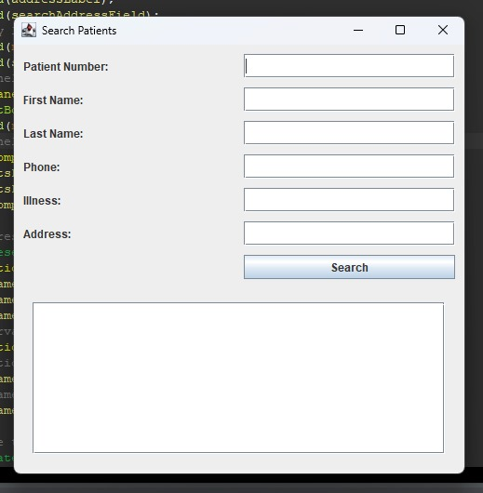
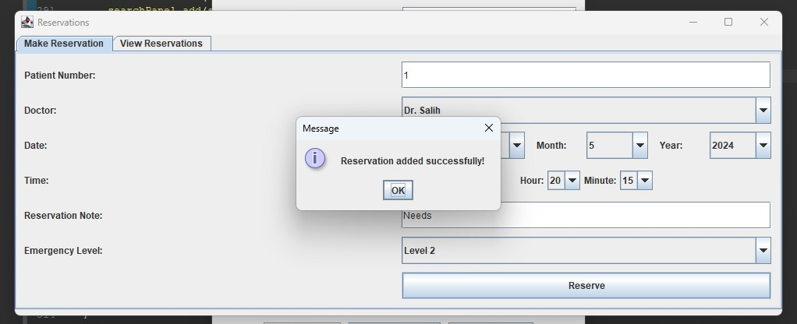
THE (HMS) SYSTEM COMPONENTS
Patient Registration panel
Patient Search panel
Reservation making panel

Slide 6
Patient Registration panel
The system starts with the registration of new patients.
A healthcare professional (receptionist or nurse) initiates the process by selecting the "Register Patient" option in the HMS system.
The system prompts the user to enter the patient's details, including their first name, last name, age, gender, contact information, address, blood type, any known illnesses, notes, weight, and height.
Once all necessary information is entered, the user submits the registration.
The system validates the input data and stores the patient's information in the database.

Slide 7
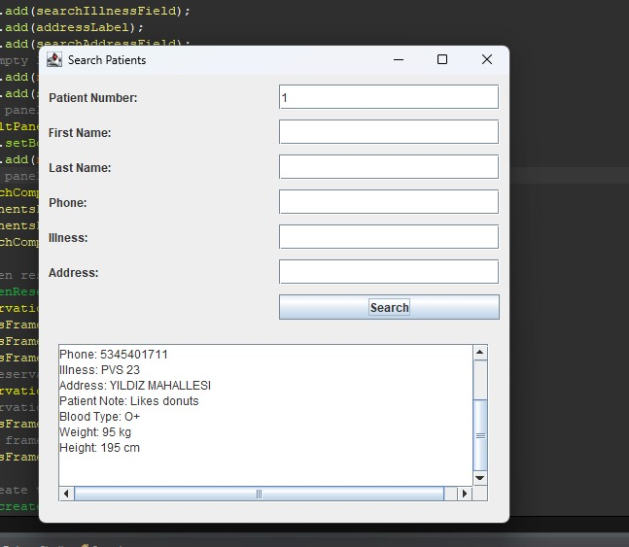
Patient Search panel
Healthcare professionals can search for existing patient records when needed.
A healthcare professional selects the "Search Patient" option in the HMS system.
The system provides various search criteria options, such as patient ID, name, illness, or other relevant parameters.
The user enters the search criteria and initiates the search.
The system retrieves matching patient records from the database and displays them to the user.

Slide 8
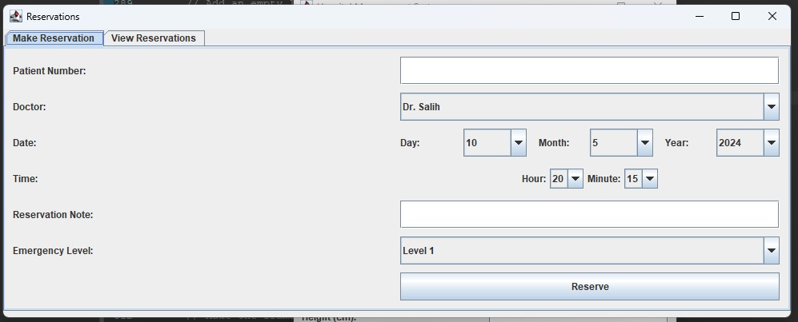
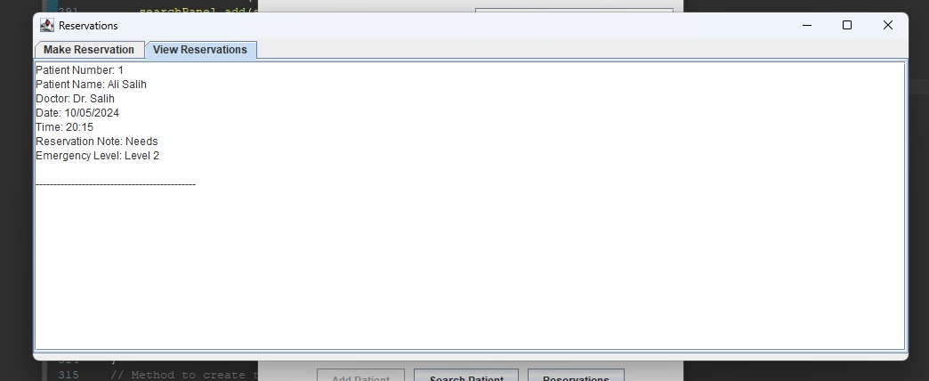
Reservation making panel
After registering a patient, healthcare professionals can schedule appointments for them.
A healthcare professional selects the "Make Reservation" option in the HMS system.
The system prompts the user to enter details for the reservation, including the patient's ID, the doctor's name, appointment date and time, reservation notes, and emergency level if applicable.
The user submits the reservation details.
The system validates the input and updates the appointment schedule accordingly.
Then you can see the reservation made in the panel of (view the reservation)

Slide 9
OBJECTİVES
Efficient Patient Management
Quick Information Retrieval
Optimized Appointment Scheduling
User-Friendly Interface

Slide 10
ABOUT THE CODE
Development Environment:
Eclipse IDE for coding and testing
Database Management: MySQL or SQLite
User Interface Development: Java Swing
Deployment: Eclipse for packaging and running
Data Structures
Array Lists: Used for storing and managing patient data.
Greedy Algorithms: Employed for optimizing tasks like patient search and appointment scheduling.

Slide 11
UNIQUE FEATURES
Text only restrictions on text fields, which doesn’t not allow numbers to be written in places that require alphabet.
Number only restrictions on Number fields, which doesn’t not allow Alphabet to be written in places that require Numbers.

Slide 12
Code Details:
Use of Array Lists, text restrictions, and event listeners.
Integration of greedy algorithms for efficient scheduling.
Implementation of date and time updaters for precise appointments.
Architectural Representation
Use Case Diagram: Illustrates interactions between healthcare professionals, patients, and doctors.
Class Diagram: Represents core entities and their relationships within the system.

Slide 13
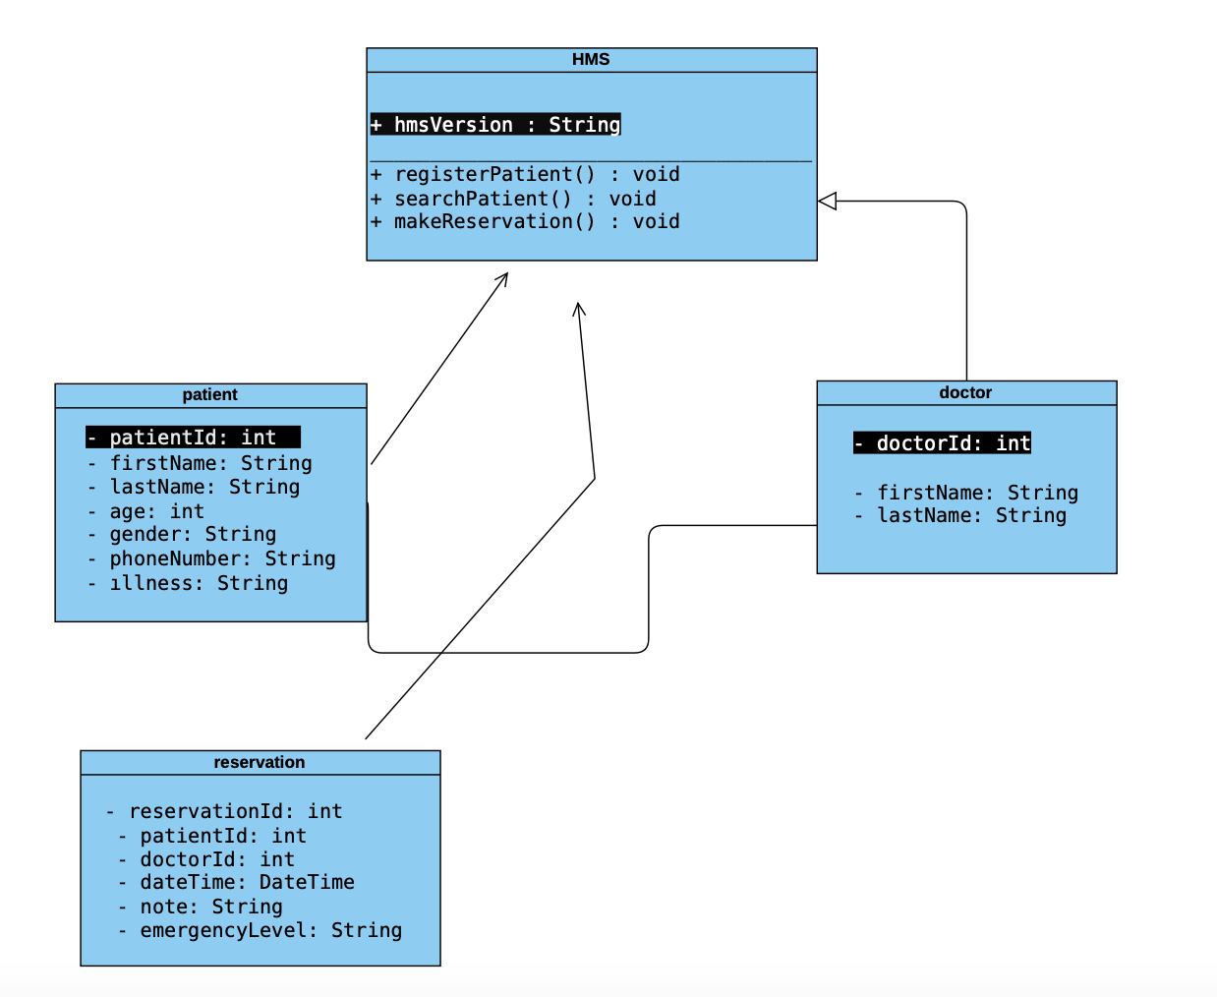
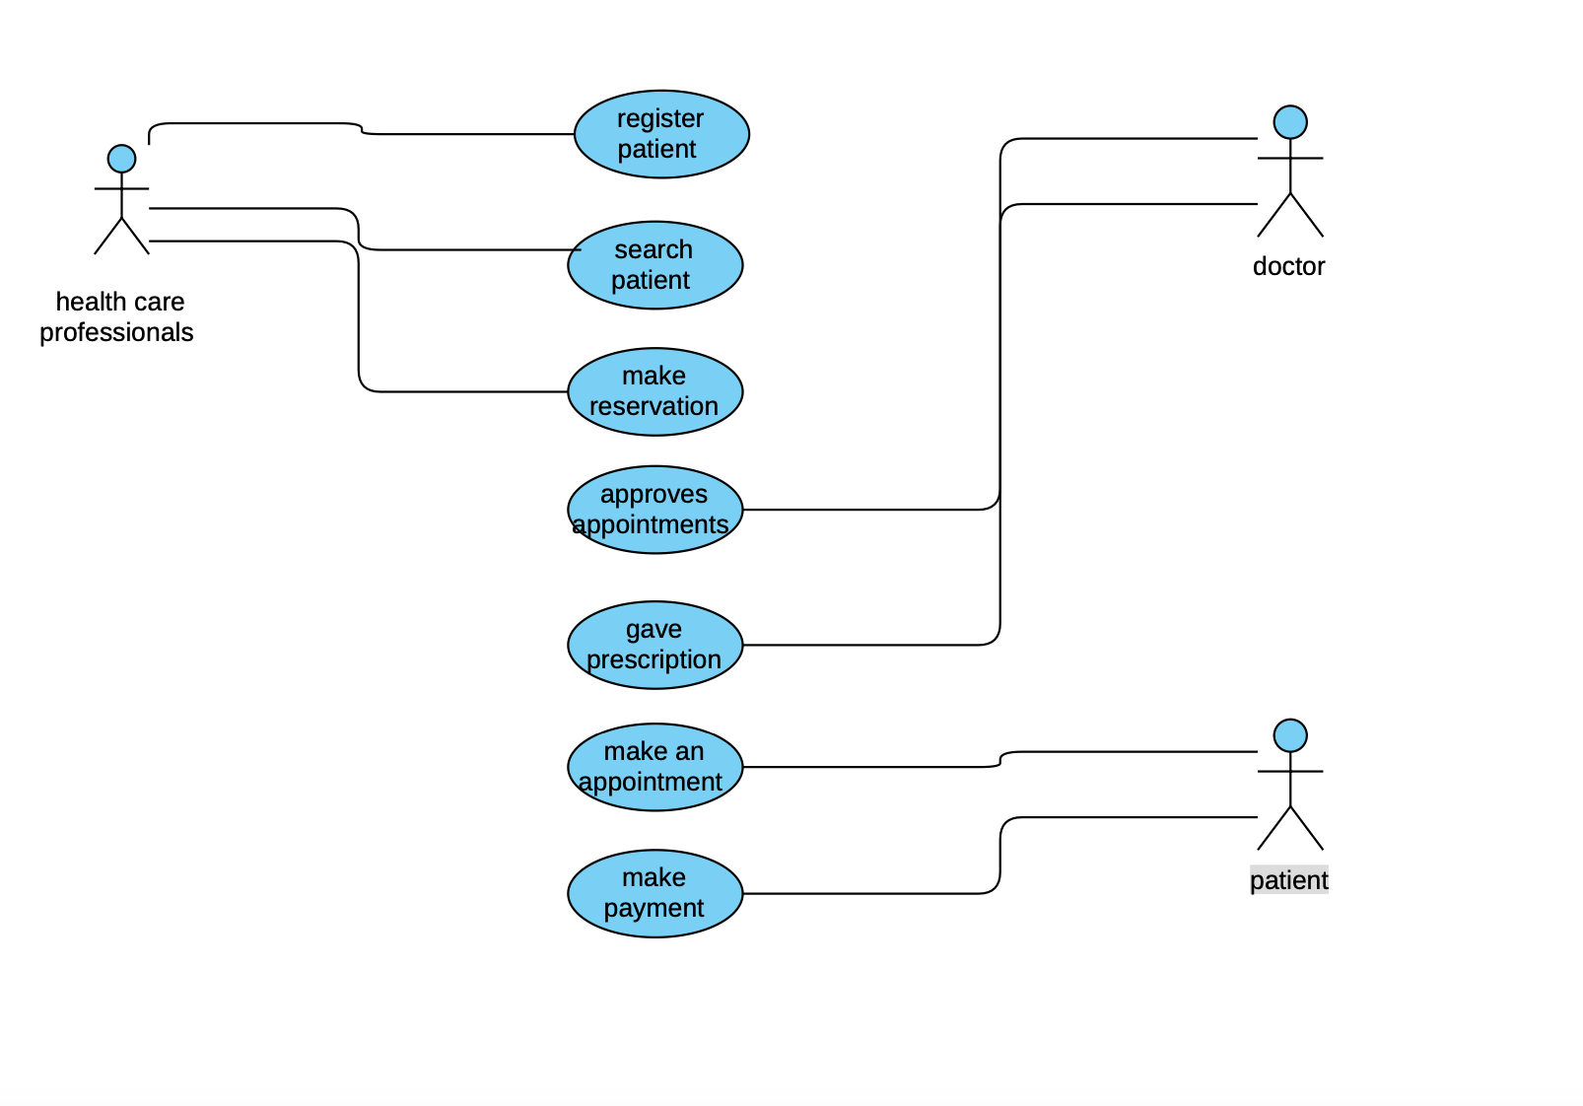
Use Case Diagram
Class Diagram

Slide 14

SUMMARY
Our Hospital Management System (HMS) helps hospitals run smoother. It makes administrative tasks easier, lets healthcare staff communicate better, and ensures patient info is always available. With features like better appointment scheduling and easier data management, our system makes healthcare more efficient

